Slide 1
Loop Solutions Inc.

Slide 2



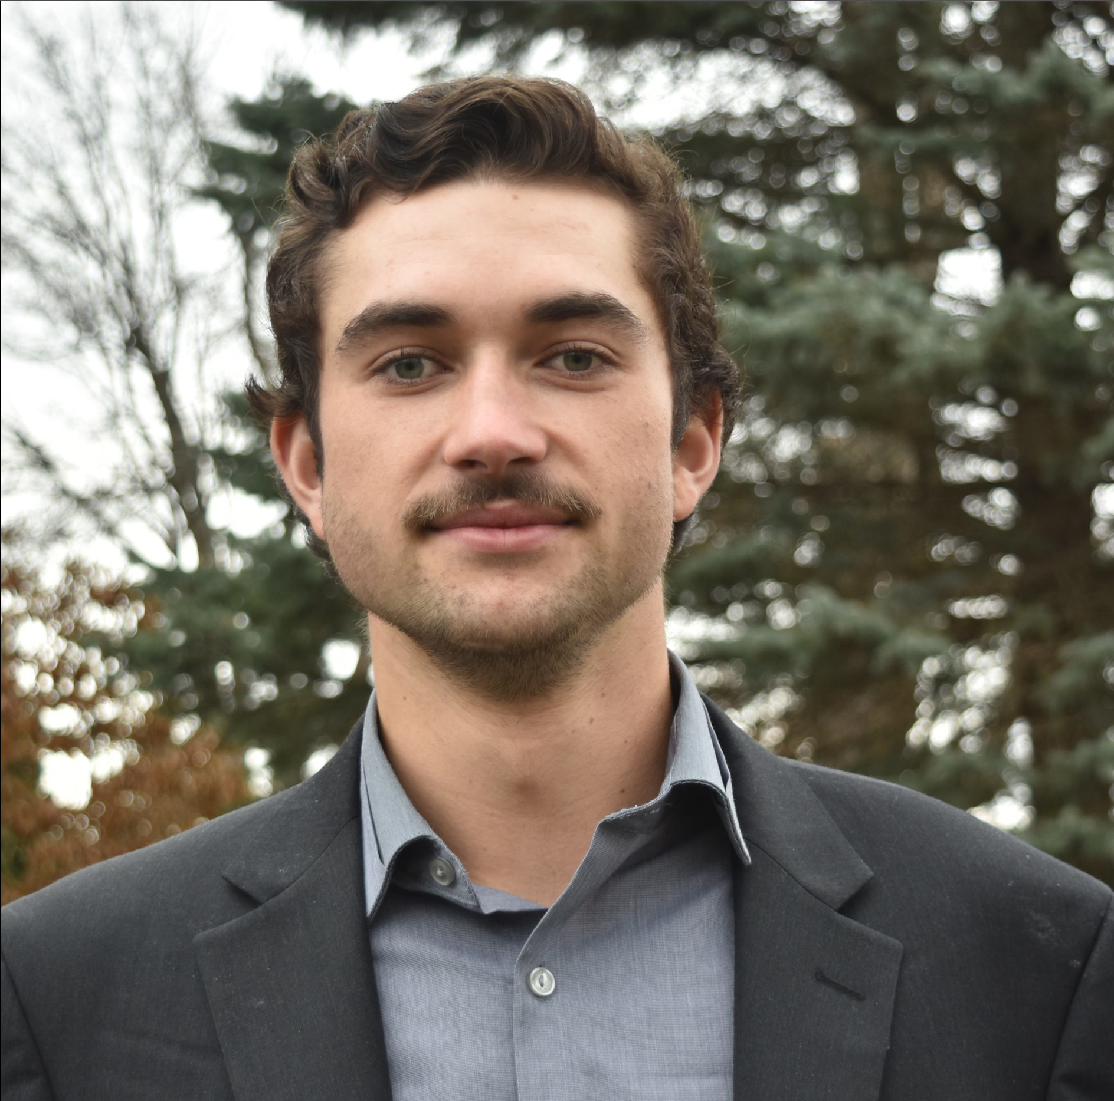
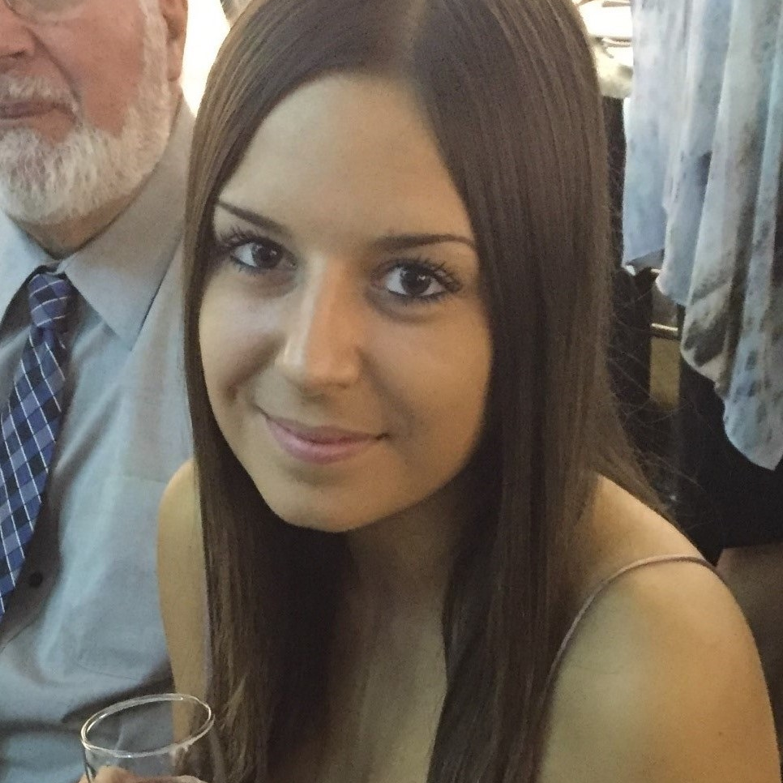

Meet the Team
Sam Mallabone
Andrew Black
Jak Terpak
Matt Northmore
Stephanie Pereira
Craig Cook

Slide 3
Problem
Bring injury treatment into the home

Slide 4

Solution

Slide 5
Design Goals
Scalability
Functionality
Usability

Slide 6
Key Features
Intuitive Dashboards
Concise Notification System
Fluid Navigation
User Experience

Slide 7
All System Features
Authenticate User
Change Password
Manage Dynamic Forms
Manage User Accounts
Complete Assessment Test
Book Appointment (Upload Image, Fill-in Injury form)
Assign Patient Plan
Complete Exercises
Create New Account
Make Payment
Visualize Treatment Results
Manage Patient Profiles
Client Dashboard
Physio Dashboard
Admin Dashboard
Forgot Password
Update Personal Information
Ask An Expert
Personal Calendar
Generate Patient Reports
Manage Rehabilitation Plans
Manage Exercises
Manage Assessment Tests
Manage Findings and Outcomes

Slide 8
Not Implemented
None

Slide 9
Future Enhancements
Integrated Video Conferencing
Full Calendar Synchronization
Enhanced Phone Usability

Slide 10
Thank You!
We at Loop Solutions would like to thank you for the opportunity to bring your idea to life.

Slide 11
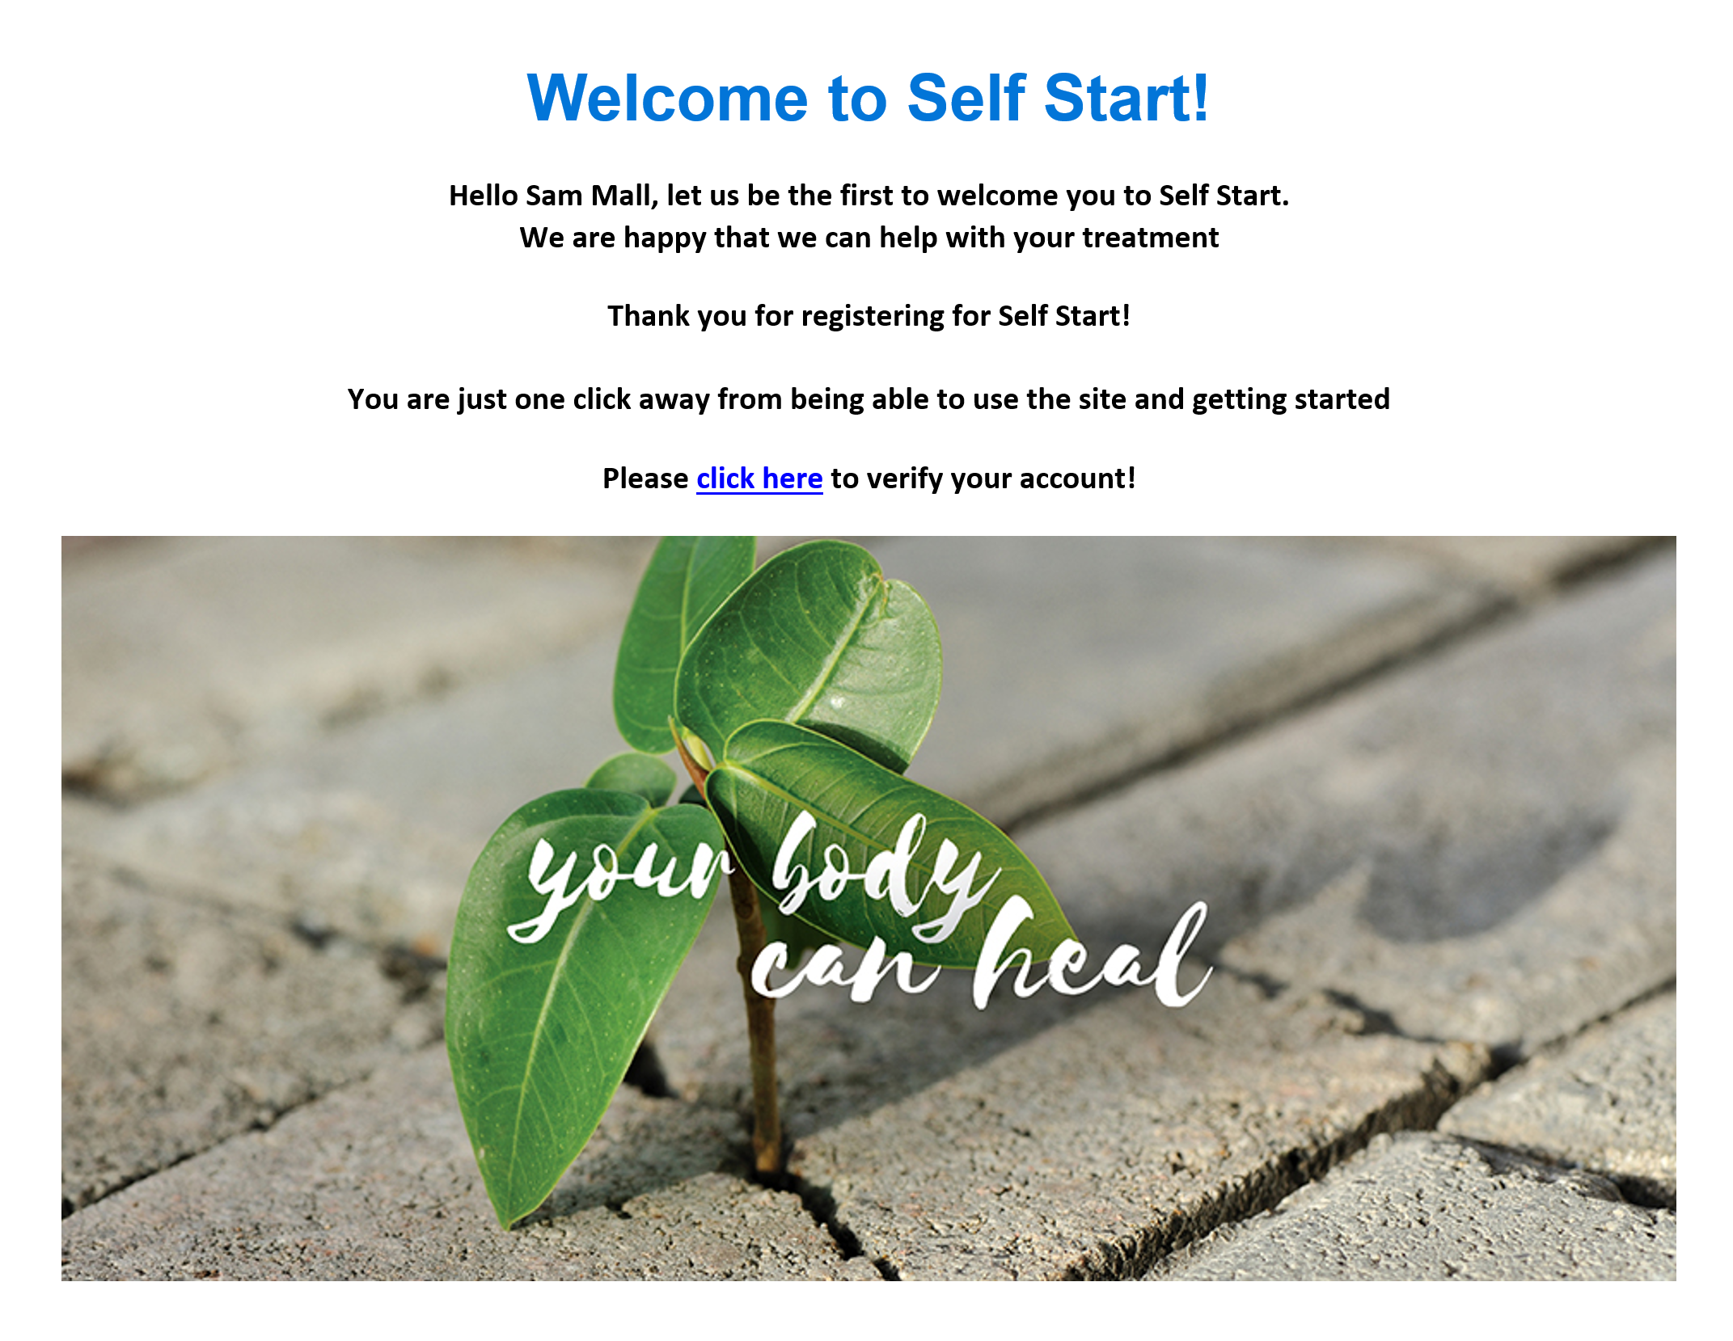

Slide 12
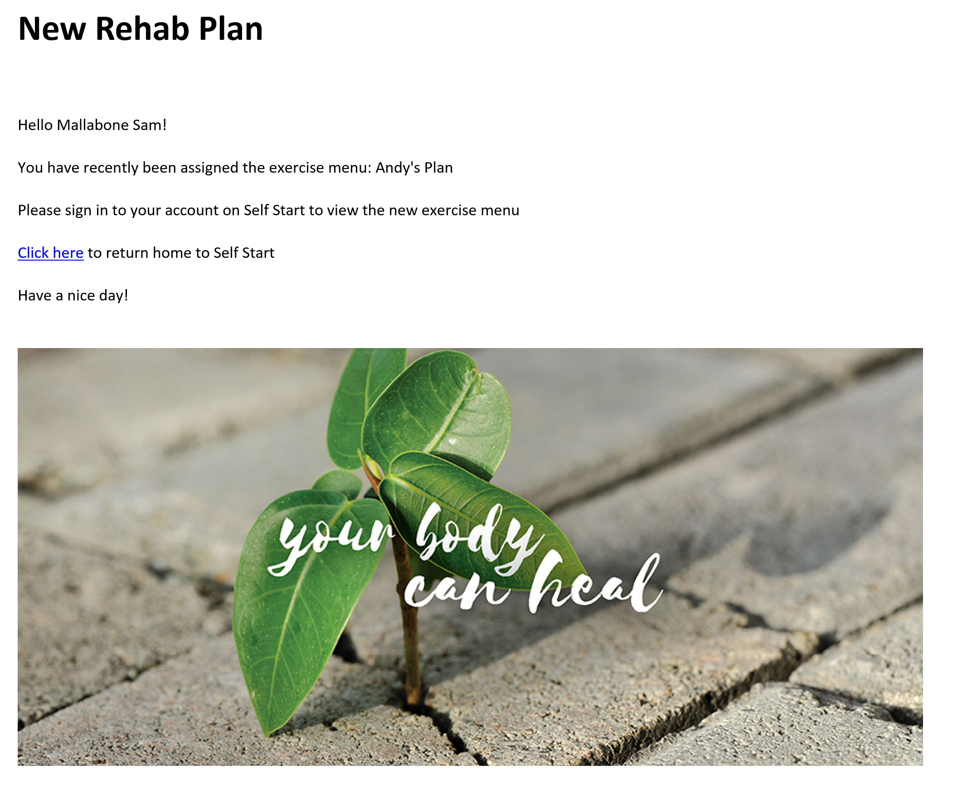

Slide 13
